Slide 1
Chapter 32 The Magnetic Field

Slide 2
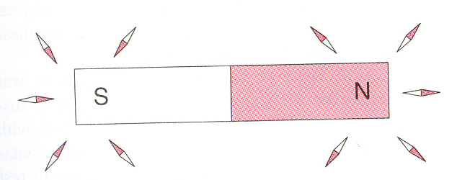
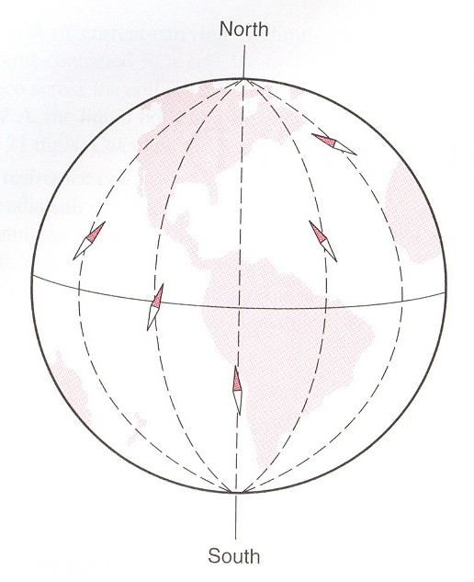
Magnetic Interactions and Magnetic Poles
S
Magnetic field of a bar magnet
Magnetic field of the Earth
N

Slide 3
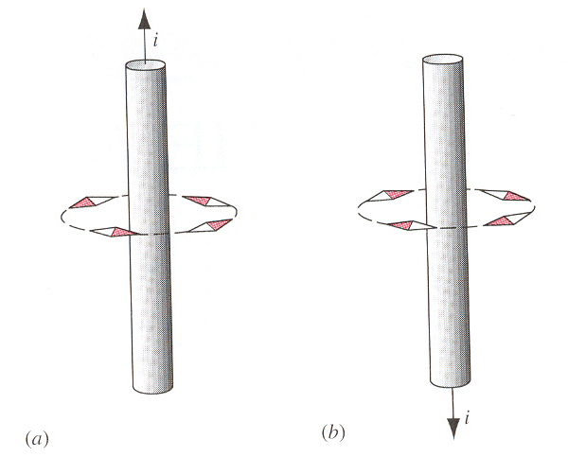
Magnetic Interactions and Magnetic Poles
Magnetic field of a current-carrying wire
Electrical Charge
many important similarities and differences between electric and magnetic
Electrical Field
Electrical Charge
Moving Electrical Charge
Magnetic Field
Moving Electrical Charge
There is a force for a charge moving relative to the the magnetic field
electric charge in motion produce magnetic field

Slide 4


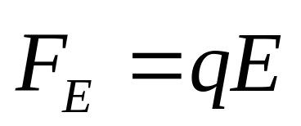
Electrical Field

Slide 5

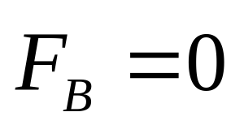
Magnetic Field

Slide 6


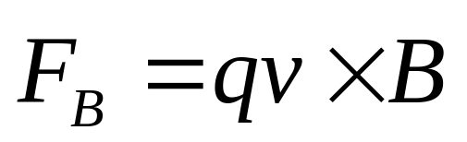
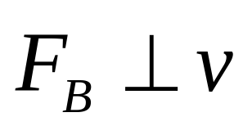
Magnetic Field
The Magnetic Force on a Moving Charge
F
B is called the magnetic induction or magnetic flux density.
B
q
θ
v
Unite of B is tesla (T) in SI.
Magnetic force cannot change the magnitude of v, only its direction. Magnetic force do no work.

Slide 7
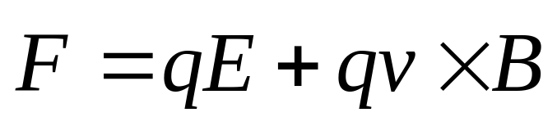
Magnetic Field
Combined electric and magnetic force
Lorentz force

Slide 8
Electrical Potential Energy
Electrical Charge
Electrical Field
Moving Electrical Charge
Magnetic Potential Energy
Magnetic Field
the magnetic force is not conservative force.

Slide 9
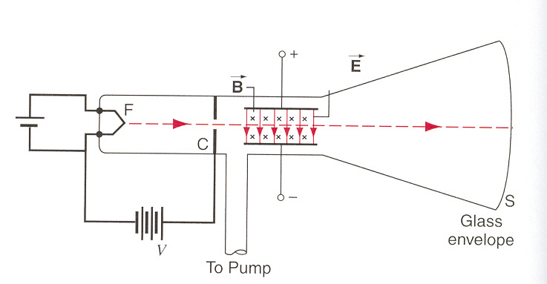
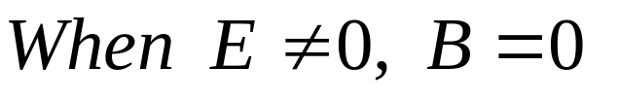




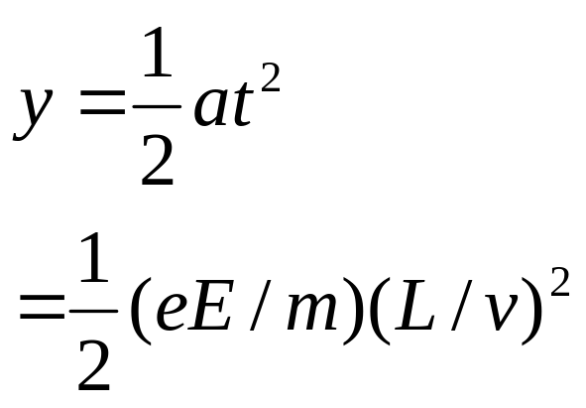
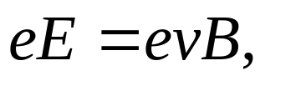
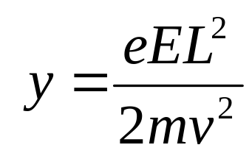
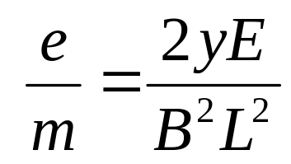
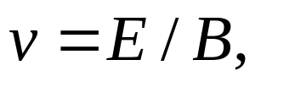
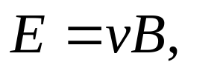
Example: A modern version of J.J.Thomson’s apparatus for measuring the charge-to-mass ratio of the electron.
charge-to-mass ratio

Slide 10
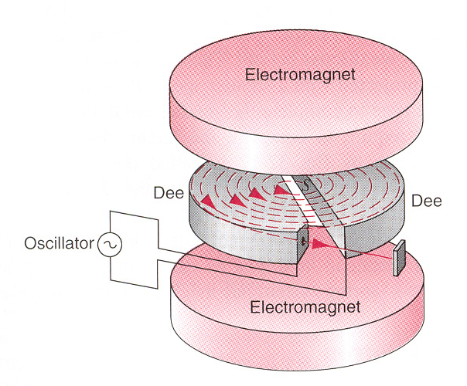
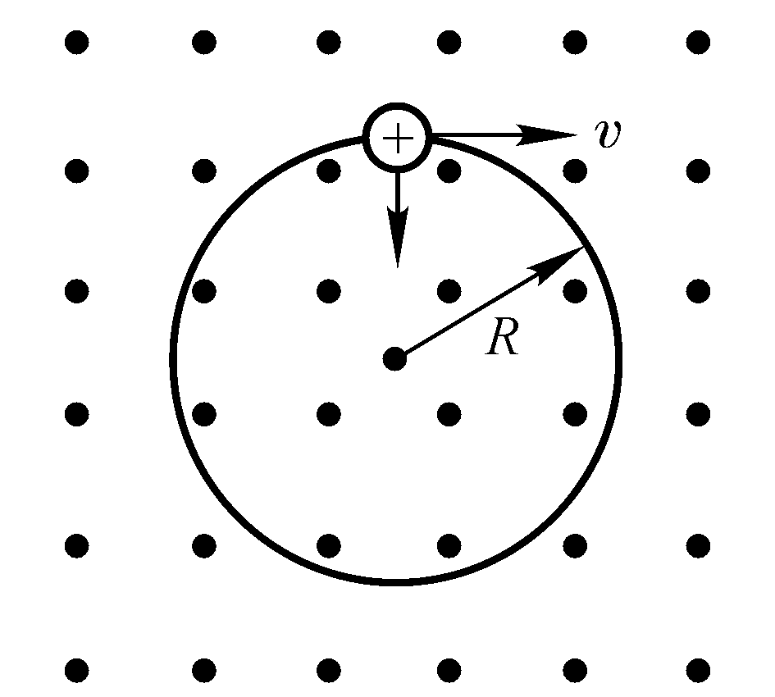
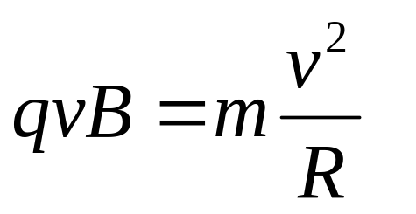
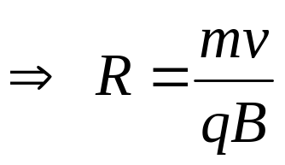
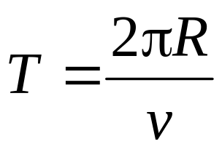
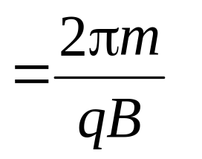
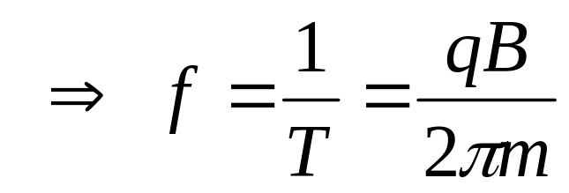
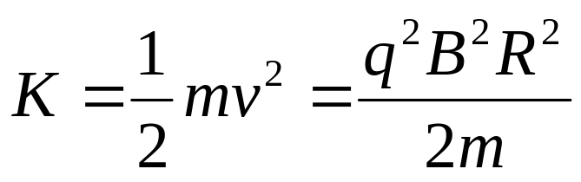
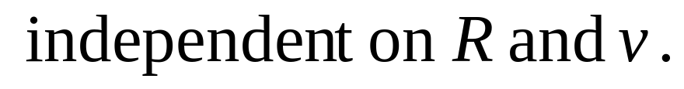
Circulating Charges

Slide 11
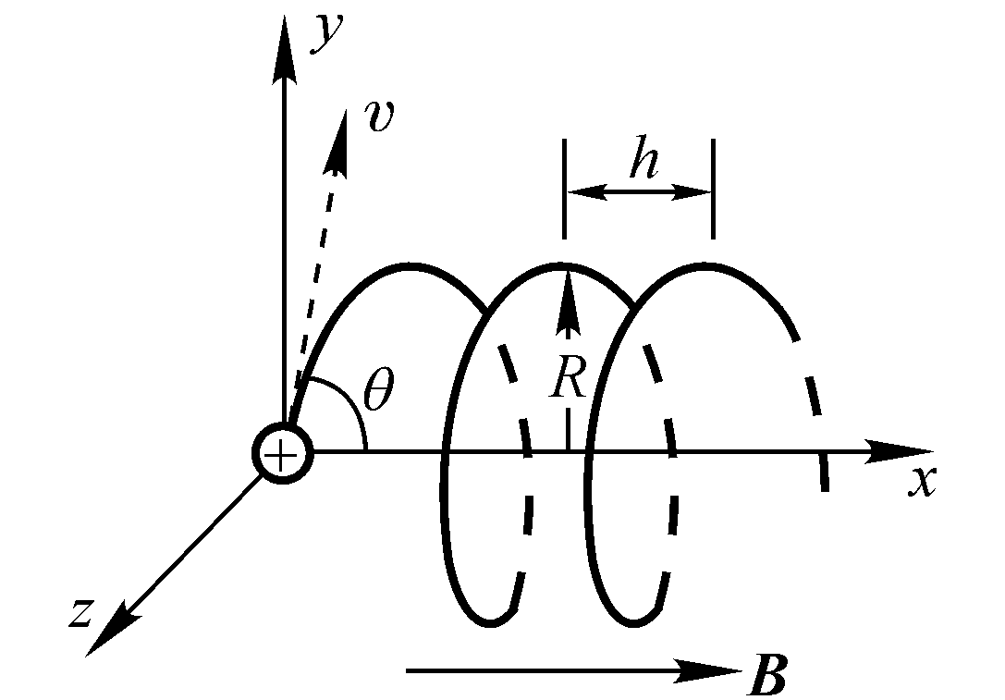
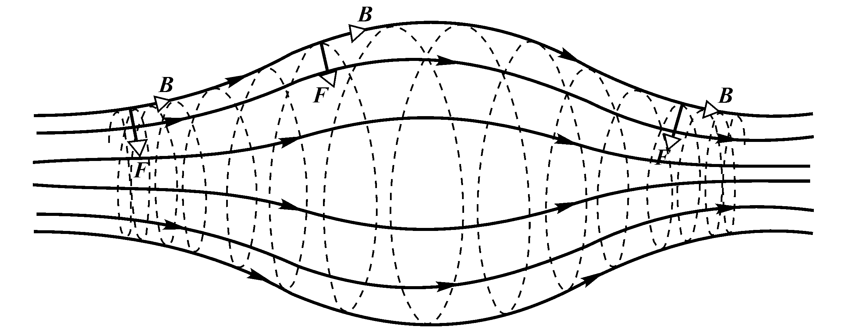
The magnetic mirror

Slide 12
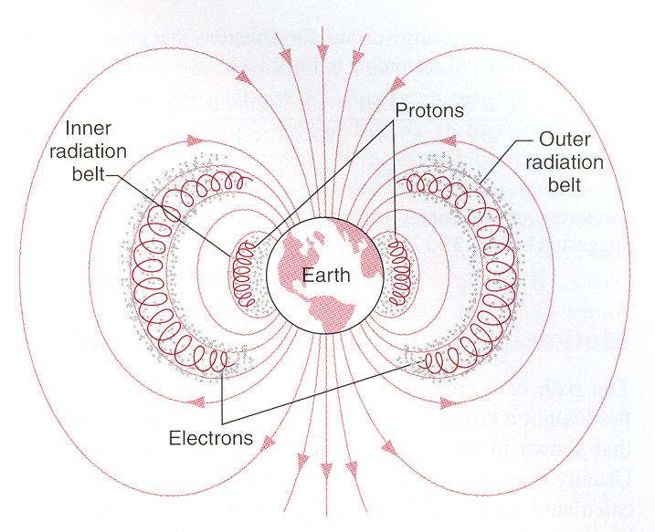
Van Allen radiation belt
Inner radiation belt—10³km
Outer radiation belt—2× 10⁴km

Slide 13
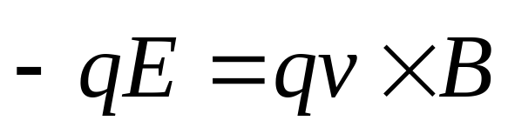


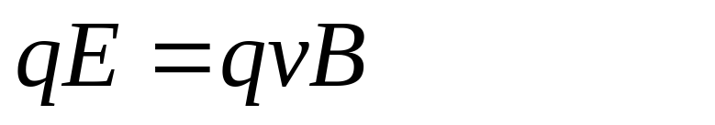
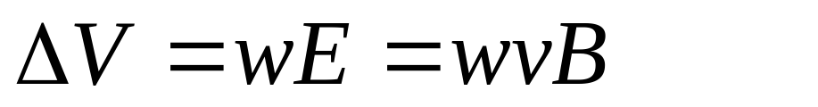





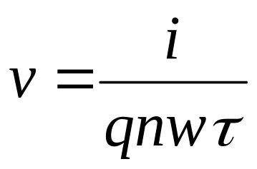
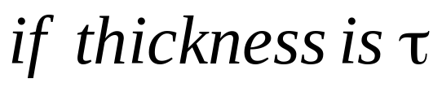
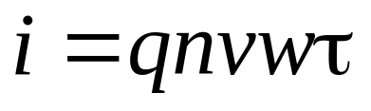

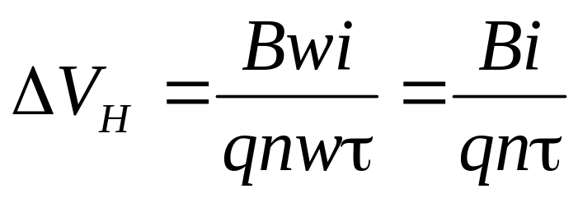
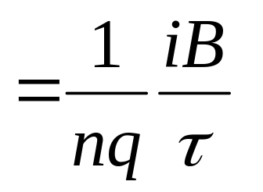
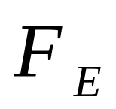
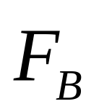
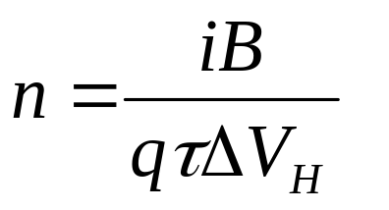
The Hall Effect
v
B

Slide 14
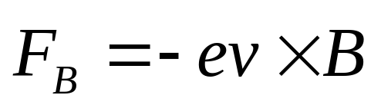
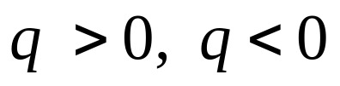
If the charge carriers is electron
The Hall Effect
v
v
B
B

Slide 15
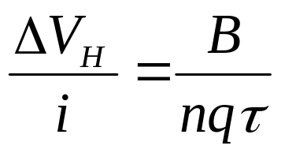
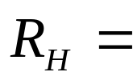

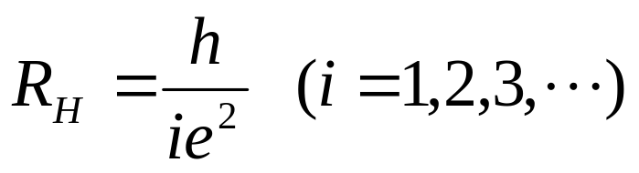
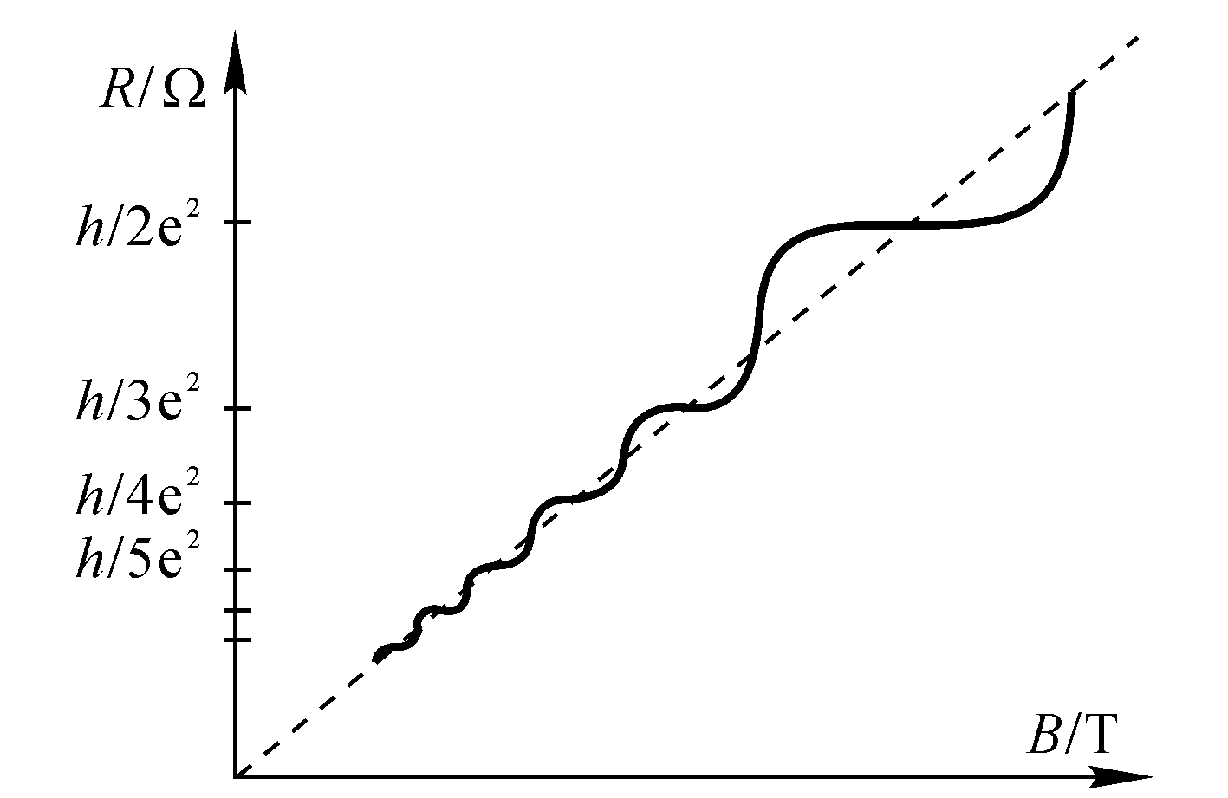
The quantized hall effect

Slide 16
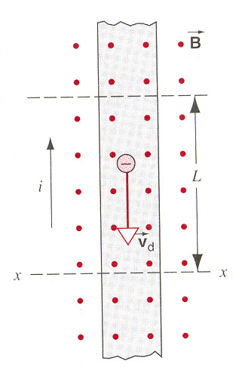
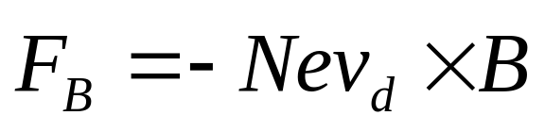
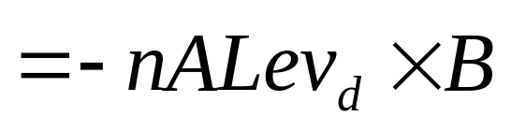
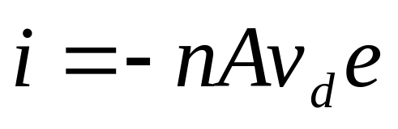
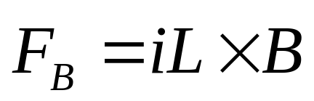


The Magnetic Force on a Current-carrying Wire
Ampere’s force
If the wire is not straight or the field is not uniform,

Slide 17






The Torque on a Current Loop
The net force on the loop is zero
Side View
Top View
The net torque on the loop is not zero.

Slide 18

Summary
Moving Electrical Charge
Magnetic Field
Moving Electrical Charge
The net torque on the loop is not zero.
The Hall Effect

Slide 19













Example

Slide 20













Example

Slide 21








Example
i
v
B

Slide 22
Problems
P746-748 6, 11, 15, 17, 19

